Slide 1

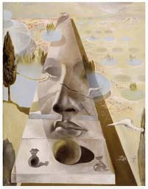
Lecture 5
Epipolar Geometry
Professor Silvio Savarese
Computational Vision and Geometry Lab
Silvio Savarese
Lecture 5 -
24-Jan-18

Slide 2
Lecture 5
Epipolar Geometry
Why is stereo useful?
Epipolar constraints
Essential and fundamental matrix
Estimating F
Examples
Reading: [AZ] Chapter: 4 “Estimation – 2D perspective transformations
Chapter: 9 “Epipolar Geometry and the Fundamental Matrix Transformation” Chapter: 11 “Computation of the Fundamental Matrix F”
[FP] Chapter: 7 “Stereopsis”
Chapter: 8 “Structure from Motion”
Silvio Savarese
Lecture 5 -
24-Jan-18

Slide 3


Recovering structure from a single view
P
p
O_{w}
Scene
Calibration rig
C
Camera K
From calibration rig → location/pose of the rig, K
From points and lines at infinity _{→ structure of the scene, K} + orthogonal lines and planes
Knowledge about scene (point correspondences, geometry of lines & planes, etc…

Slide 4
Recovering structure from a single view
P
p
O_{w}
Scene
C
Camera K
Calibration rig
Why is it so difficult?
Intrinsic ambiguity of the mapping from 3D to image (2D)

Slide 5
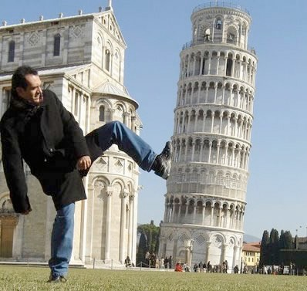
Recovering structure from a single view
Intrinsic ambiguity of the mapping from 3D to image (2D)
Courtesy slide S. Lazebnik

Slide 6
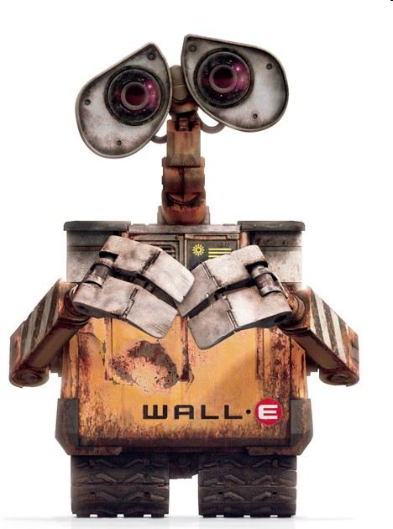
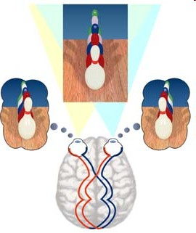
Two eyes help!

Slide 7




Two eyes help!
P = l × l'
[Eq. 1]
P
l'
l
p’
p
K =known
K’ =known
R, T
O₁
O₂
This is called triangulation

Slide 8

Triangulation
Find P* that minimizes
d( p, M P*) + d( p', M ' P*)
[Eq. 2]
P
P*
MP*
M’P* _{p’}
p
O₁
O₂

Slide 9
Multi (stereo)-view geometry
Camera geometry: Given corresponding points in two images, find camera matrices, position and pose.
Scene geometry: Find coordinates of 3D point from its projection into 2 or multiple images.
Correspondence: Given a point p in one image, how can I find the corresponding point p’ in another one?

Slide 10
Epipolar geometry
P
p
p’
e
e’
O₁
O₂
• Epipolar Plane • Epipoles e, e’
• Baseline = intersections of baseline with image planes
_{• Epipolar Lines} = projections of the other camera center

Slide 11
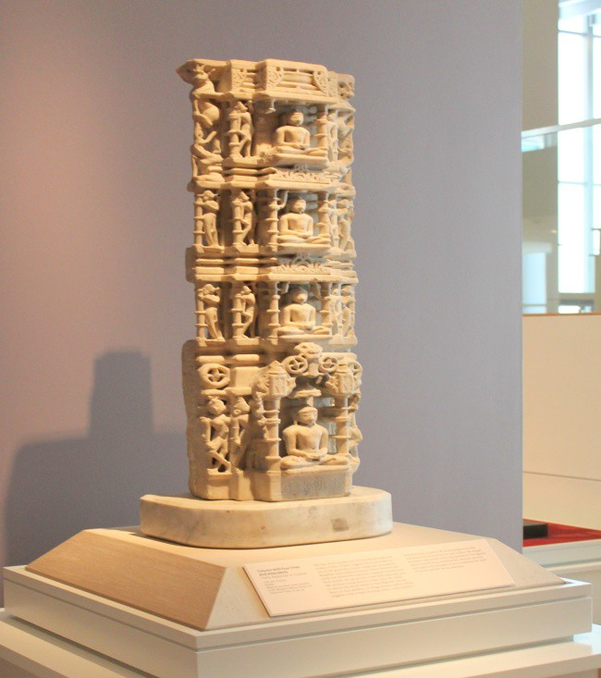
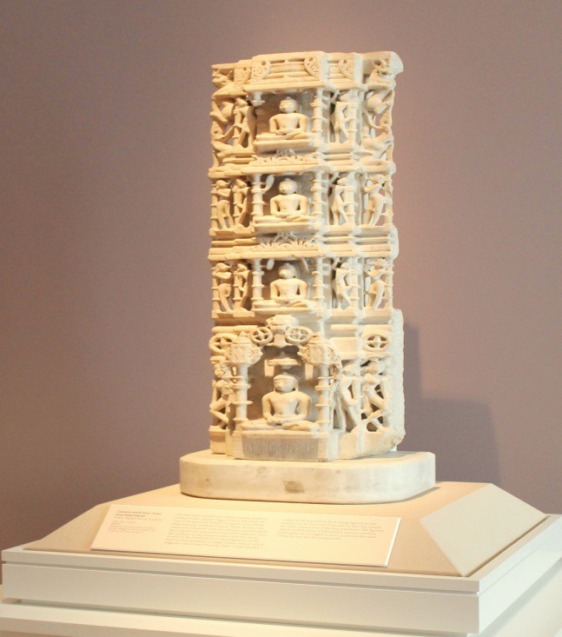
Example of epipolar lines

Slide 12
Example: Parallel image planes
P
v
v
e
e’
p
p’
u
u
O₁
O₂
Baseline intersects the image plane at infinity
Epipoles are at infinity
Epipolar lines are parallel to u axis

Slide 13
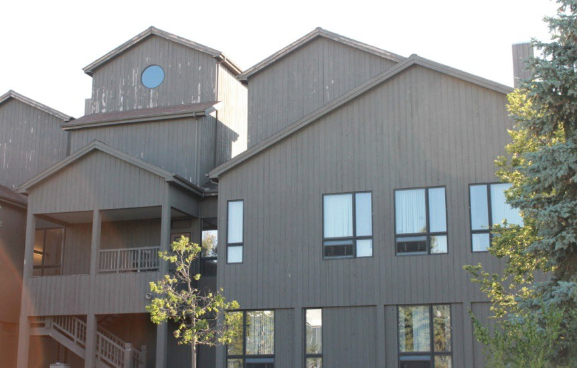
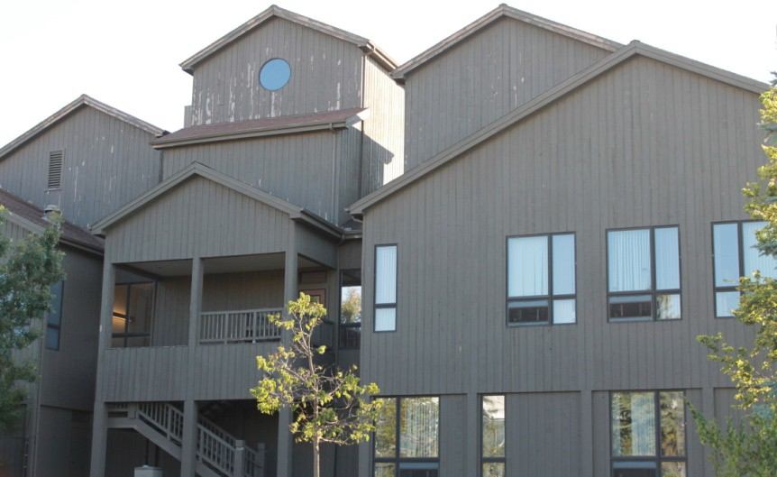
Example: Parallel Image Planes

Slide 14
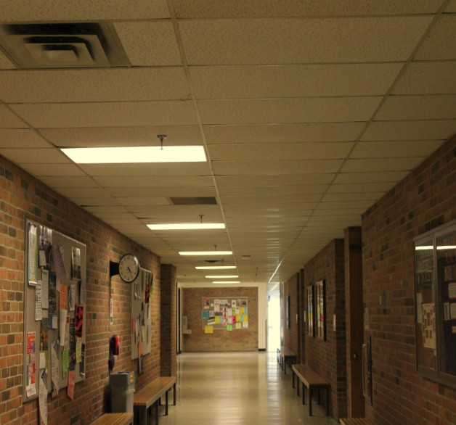
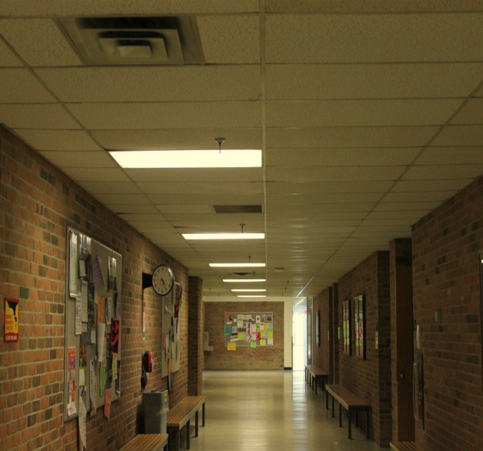
Example: Forward translation
P
e’
O₂
e
O₁
The epipoles have same position in both images
Epipole called FOE (focus of expansion)

Slide 15
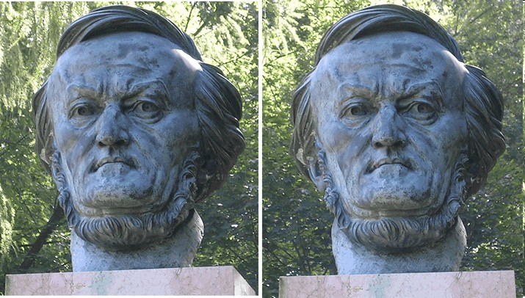

Epipolar Constraint
Where is p’?
p
Two views of the same object
Given a point on left image, how can I find the corresponding point on right image?

Slide 16
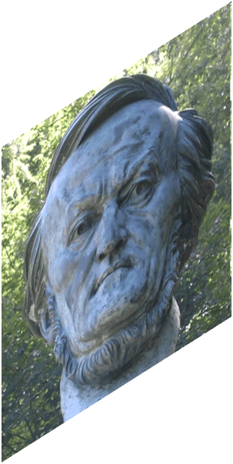
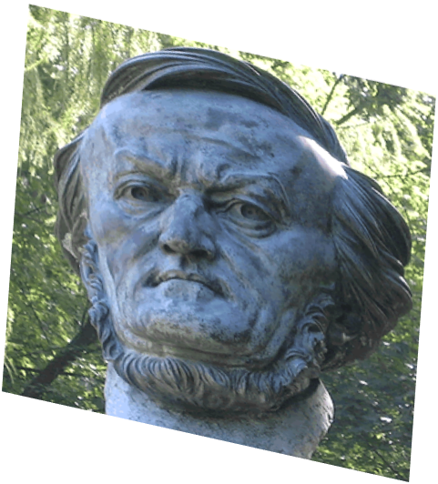
Epipolar geometry
P
Epipolar line 2
p
p’
O₁
O₂

Slide 17
Epipolar Constraint
Epipolar line 2
p’
p

Slide 18

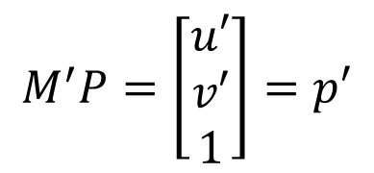

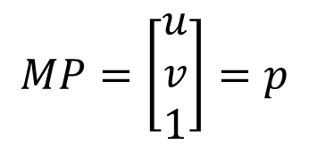

Epipolar Constraint
P
v
p’
p
u
O₁
R, T
O₂
$$M=K[ I 0 ]$$
$$M^{′}=K′\left[R^{T}−R^{T}T\right]$$
[Eq. 3]
$$MP=\left[\begin{matrix}u \\ v \\ 1\end{matrix}\right]=p$$
$$M^{′}P=\left[\begin{matrix}u′ \\ v′ \\ 1\end{matrix}\right]=p′$$
[Eq. 4]

Slide 19




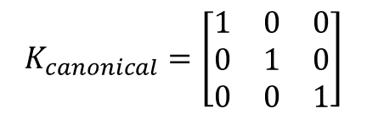
Epipolar Constraint
P
$$K_{canonical}=\left[\begin{matrix}1 & 0 & 0 \\ 0 & 1 & 0 \\ 0 & 0 & 1\end{matrix}\right]$$
p’
p
O₁
R, T
O₂
$$M=K[ I 0 ]$$
K = K’ are known (canonical cameras)
$$M^{′}=K^{′}[ R^{T}−R^{T}T]$$
$$M=[ I 0 ]$$
$$M^{′}=[R^{T}−R^{T}T]$$
[Eq. 6]
[Eq. 5]

Slide 20
The cameras are related by R, T
Camera 2
p’
T
O₂
Camera 1
O₁
T = O₂ in the camera 1 reference system
R is the rotation matrix such that a vector p’ in the camera 2 is equal to R p’ in camera 1.

Slide 21


Epipolar Constraint
P
p’
p
O₁
R, T
O₂
p’ in first camera reference system is = R p'+ T
$$T×\left(\left(Rp^{′}\right)+T\right)=T×(Rp′)$$
is perpendicular to epipolar plane
$$→p^{T}∙\left[T×\left(Rp^{′}\right)\right]=0$$
[Eq. 7]

Slide 22
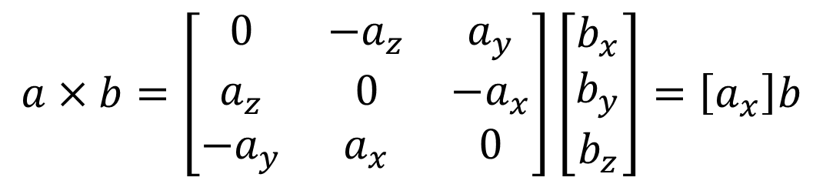
Cross product as matrix multiplication
$$a×b=\left[\begin{matrix}0 & −a_{z} & a_{y} \\ a_{z} & 0 & −a_{x} \\ −a_{y} & a_{x} & 0\end{matrix}\right]\left[\begin{matrix}b_{x} \\ b_{y} \\ b_{z}\end{matrix}\right]=\left[a_{x}\right]b$$

Slide 23
Epipolar Constraint
P
p’
p
O₁
R, T
O₂
[Eq. 8]
[Eq. 9]
E = Essential matrix
(Longuet-Higgins, 1981)
$$p^{T}∙\left[T×\left(Rp^{′}\right)\right]=0→p^{T}∙\left[T_{x}\right]∙Rp^{′}=0$$

Slide 24


Epipolar Constraint
P
p^{T} ⋅ E p' = 0
[Eq. 10]
p
p’
l
l’
e
e’
O₁
O₂
• l = E p’ is the epipolar line associated with p’
• l’ = E^{T} p is the epipolar line associated with p
• E e’ = 0 and E^{T} e = 0
• E is 3x3 matrix; 5 DOF
• E is singular (rank two)

Slide 25




Epipolar Constraint
P
p’
p
O₁
R, T
O₂
$$M=K[I 0]$$
$$M^{′}=K^{′}[R^{T}−R^{T}T]$$
$$p_{c}=K^{−1}p$$
$$p_{c}^{′}={K′}^{−1}p′$$
[Eq. 12]
[Eq. 11]

Slide 26


Epipolar Constraint
P
$$p_{c}^{}=K^{−1}p$$
[Eq. 11]
$$p_{c}^{′}={K′}^{−1}p′$$
[Eq. 12]
p’
p
O₁
O₂
[Eq.9]
$${p_{c}}^{T}∙\left[T_{x}\right]∙Rp_{c}^{′}=0→{\left(K^{−1}p\right)}^{T}∙\left[T_{x}\right]∙R{K^{′}}^{−1}p^{′}=0$$
$$p^{T}K^{−T}∙\left[T_{x}\right]∙R{K^{′}}^{−1}p^{′}=0→p^{T}Fp^{′}=0$$
[Eq. 13]

Slide 27

Epipolar Constraint
P
p’
p
O₁
O₂
[Eq. 13] _{p}^{T} _{F p}′ ₌ ₀
F = Fundamental Matrix ^{[Eq. 14]}
(Faugeras and Luong, 1992)
$$F=K^{−T}∙[T_{x}]∙R{K′}^{−1}$$

Slide 28
Epipolar Constraint
p^{T} ⋅ F p' = 0
P
p
p’
l
l’
e
e’
O₁
O₂
• l = F p’ is the epipolar line associated with p’
• l’= F^{T} p is the epipolar line associated with p
• F e’ = 0 and F^{T} e = 0
• F is 3x3 matrix; 7 DOF
• F is singular (rank two)

Slide 29
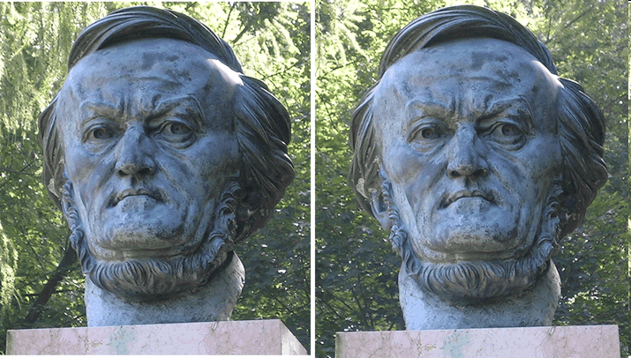
Why F is useful?
l’ = F^{T} p
p
p’
Suppose F is known
No additional information about the scene and camera is given
Given a point on left image, we can compute the corresponding epipolar line in the second imag

Slide 30
Why F is useful?
F captures information about the epipolar geometry of 2 views + camera parameters
MORE IMPORTANTLY: F gives constraints on how the scene changes under view point transformation (without reconstructing the scene!)
Powerful tool in:
3D reconstruction
Multi-view object/scene matching

Slide 31

Estimating F
The Eight-Point Algorithm
(Longuet-Higgins, 1981)
P
(Hartley, 1995)
p’
p
O₁
O₂
p^{T} F p′ = 0

Slide 32
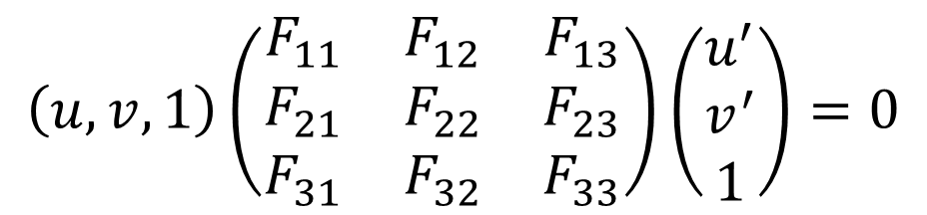
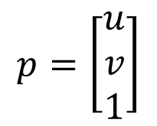
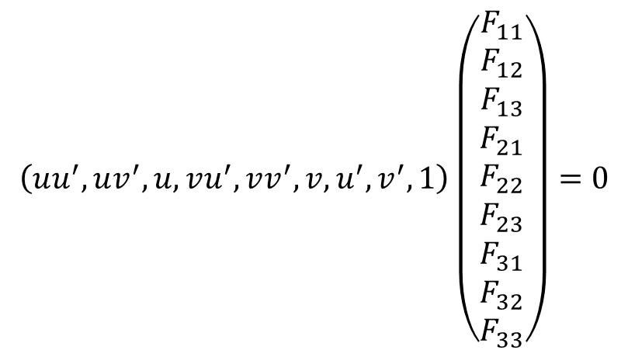
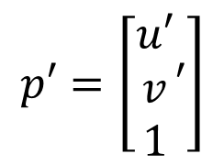
Estimating F
$$p=\left[\begin{matrix}u \\ v \\ 1\end{matrix}\right]$$
$$p′=\left[\begin{matrix}u′ \\ v \\ 1\end{matrix}′\right]$$
T
[Eq. 13]
p F p′ = 0
$$\left(u,v,1\right)\left(\begin{matrix}F_{11} & F_{12} & F_{13} \\ F_{21} & F_{22} & F_{23} \\ F_{31} & F_{32} & F_{33}\end{matrix}\right)\left(\begin{matrix}u^{′} \\ v^{′} \\ 1\end{matrix}\right)=0$$
$$\left(uu^{′},uv^{′},u,vu^{′},vv^{′},v,u^{′},v^{′},1\right)\left(\begin{matrix}\begin{aligned}F_{11} \\ F_{12}\end{aligned} \\ F_{13} \\ \begin{aligned}F_{21} \\ F_{22} \\ F_{23} \\ F_{31} \\ F_{32} \\ F_{33}\end{aligned}\end{matrix}\right)=0$$
Let’s take 8 corresponding points
[Eq. 14]

Slide 33







Estimating F

Slide 34
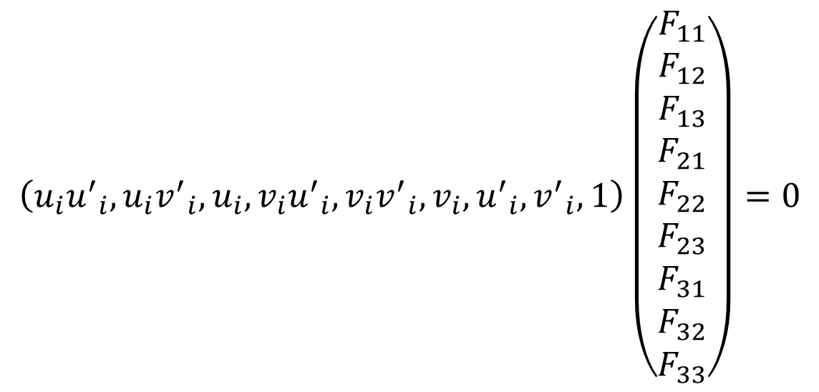
Estimating F
$$\left(u_{i}{u^{′}}_{i},u_{i}{v^{′}}_{i},u_{i},v_{i}{u^{′}}_{i},v_{i}{v^{′}}_{i},v_{i},{u^{′}}_{i},{v^{′}}_{i},1\right)\left(\begin{matrix}\begin{aligned}F_{11} \\ F_{12}\end{aligned} \\ F_{13} \\ \begin{aligned}F_{21} \\ F_{22} \\ F_{23} \\ F_{31} \\ F_{32} \\ F_{33}\end{aligned}\end{matrix}\right)=0$$
[Eq. 14]

Slide 35

Estimating F
$$\left(\begin{matrix}u_{1}{u^{′}}_{1} & u_{1}{v^{′}}_{1} & u_{1} \\ u_{2}{u^{′}}_{2} & u_{2}{v^{′}}_{2} & u_{2} \\ \begin{aligned}u_{3}{u^{′}}_{3} \\ u_{4}{u^{′}}_{4} \\ u_{5}{u^{′}}_{5} \\ u_{6}{u^{′}}_{6} \\ u_{7}{u^{′}}_{7} \\ u_{8}{u^{′}}_{8}\end{aligned} & \begin{aligned}u_{3}{v^{′}}_{3} \\ u_{4}{v^{′}}_{4} \\ u_{5}{v^{′}}_{5} \\ u_{6}{v^{′}}_{6} \\ u_{7}{v^{′}}_{7} \\ u_{8}{v^{′}}_{8}\end{aligned} & \begin{aligned}u_{3} \\ u_{4} \\ u_{5} \\ u_{6} \\ u_{7} \\ u_{8}\end{aligned}\end{matrix} \begin{matrix}v_{1}{u^{′}}_{1} & v_{1}{v^{′}}_{1} & v_{1} \\ v_{2}{u^{′}}_{2} & v_{2}{v^{′}}_{2} & v_{2} \\ \begin{aligned}v_{3}{u^{′}}_{3} \\ v_{4}{u^{′}}_{4} \\ v_{5}{u^{′}}_{5} \\ v_{6}{u^{′}}_{6} \\ v_{7}{u^{′}}_{7} \\ v_{8}{u^{′}}_{8}\end{aligned} & \begin{aligned}v_{3}{v^{′}}_{3} \\ v_{4}{v^{′}}_{4} \\ v_{5}{v^{′}}_{5} \\ v_{6}{v^{′}}_{6} \\ v_{7}{v^{′}}_{7} \\ v_{8}{v^{′}}_{8}\end{aligned} & \begin{aligned}v_{3} \\ v_{4} \\ v_{5} \\ v_{6} \\ v_{7} \\ v_{8}\end{aligned}\end{matrix} \begin{matrix}{u^{′}}_{1} & {v^{′}}_{1} & 1 \\ {u^{′}}_{2} & {v^{′}}_{2} & 1 \\ \begin{aligned}{u^{′}}_{3} \\ {u^{′}}_{4} \\ {u^{′}}_{5} \\ {u^{′}}_{6} \\ {u^{′}}_{7} \\ {u^{′}}_{8}\end{aligned} & \begin{aligned}{v^{′}}_{3} \\ {v^{′}}_{4} \\ {v^{′}}_{5} \\ {v^{′}}_{6} \\ {v^{′}}_{7} \\ {v^{′}}_{8}\end{aligned} & \begin{aligned}1 \\ 1 \\ 1 \\ 1 \\ 1 \\ 1\end{aligned}\end{matrix}\right)\left(\begin{matrix}\begin{aligned}F_{11} \\ F_{12}\end{aligned} \\ F_{13} \\ \begin{aligned}F_{21} \\ F_{22} \\ F_{23} \\ F_{31} \\ F_{32} \\ F_{33}\end{aligned}\end{matrix}\right)=0$$
[Eqs. 15]
W
f
Homogeneous system W f = 0
Rank 8
If N>8
A non-zero solution exists (unique)
Lsq. solution by SVD!
_{F}ˆ
f = 1

Slide 36
F^{ˆ} satisfies: p^{T} F^{ˆ} p′ = 0
and estimated F^ may have full rank (det(^F) ≠0)
But remember: fundamental matrix is Rank2
F − F^{ˆ} = 0
Frobenius norm (*)
Find F that minimizes
Subject to det(F)=0
SVD (again!) can be used to solve this problem
(*) Sq. root of the sum of squares of all entries

Slide 37
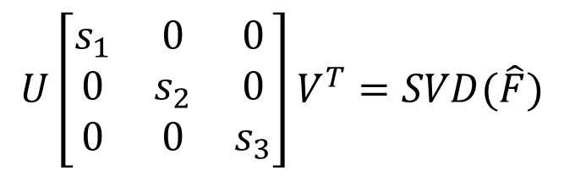
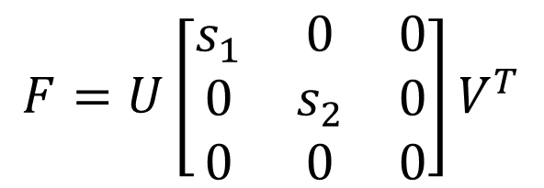
F − F^{ˆ} = 0
Find F that minimizes
Frobenius norm (*)
Subject to det(F)=0
$$F=U\left[\begin{matrix}s_{1} & 0 & 0 \\ 0 & s_{2} & 0 \\ 0 & 0 & 0\end{matrix}\right]V^{T}$$
Where:
$$U\left[\begin{matrix}s_{1} & 0 & 0 \\ 0 & s_{2} & 0 \\ 0 & 0 & s_{3}\end{matrix}\right]V^{T}=SVD(\hat{F})$$
[HZ] pag 281, chapter 11, “Computation of F”

Slide 38
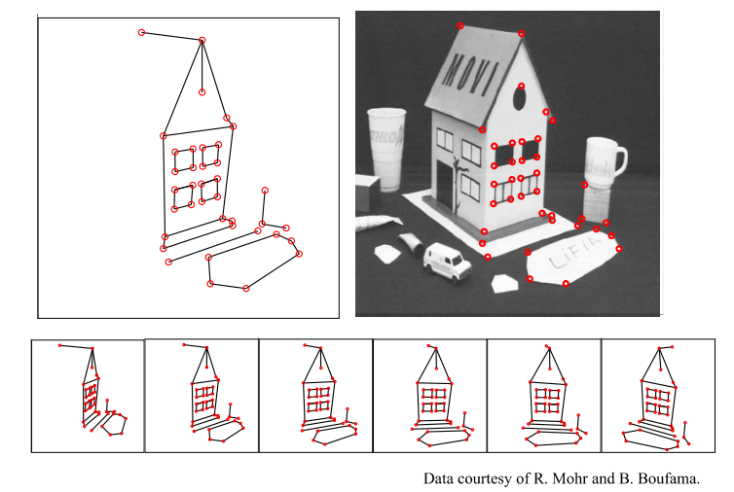

Slide 39
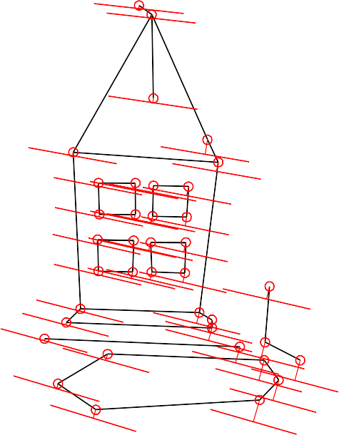
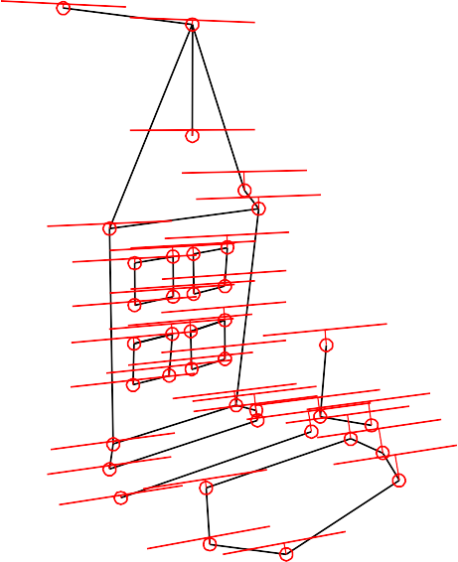
Mean errors: 10.0pixel 9.1pixel

Slide 40
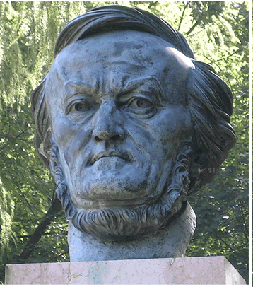








Problems with the 8-Point Algorithm
W f = 0,
Lsq solution by SVD
F
f = 1
- Recall the structure of W:
- do we see any potential (numerical) issue?

Slide 41
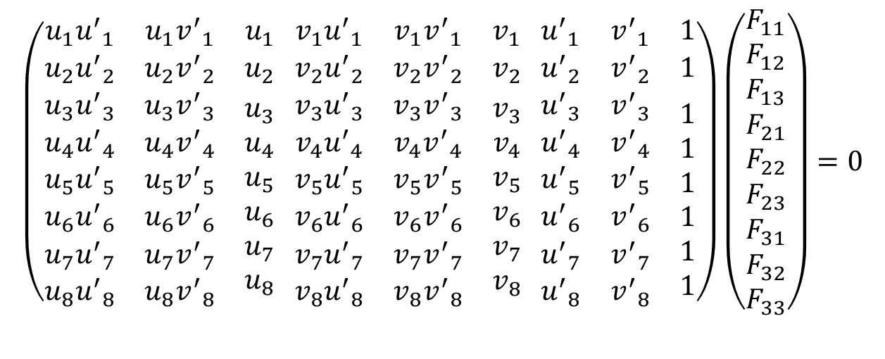
Problems with the 8-Point Algorithm
Wf = 0
$$\left(\begin{matrix}u_{1}{u^{′}}_{1} & u_{1}{v^{′}}_{1} & u_{1} \\ u_{2}{u^{′}}_{2} & u_{2}{v^{′}}_{2} & u_{2} \\ \begin{aligned}u_{3}{u^{′}}_{3} \\ u_{4}{u^{′}}_{4} \\ u_{5}{u^{′}}_{5} \\ u_{6}{u^{′}}_{6} \\ u_{7}{u^{′}}_{7} \\ u_{8}{u^{′}}_{8}\end{aligned} & \begin{aligned}u_{3}{v^{′}}_{3} \\ u_{4}{v^{′}}_{4} \\ u_{5}{v^{′}}_{5} \\ u_{6}{v^{′}}_{6} \\ u_{7}{v^{′}}_{7} \\ u_{8}{v^{′}}_{8}\end{aligned} & \begin{aligned}u_{3} \\ u_{4} \\ u_{5} \\ u_{6} \\ u_{7} \\ u_{8}\end{aligned}\end{matrix} \begin{matrix}v_{1}{u^{′}}_{1} & v_{1}{v^{′}}_{1} & v_{1} \\ v_{2}{u^{′}}_{2} & v_{2}{v^{′}}_{2} & v_{2} \\ \begin{aligned}v_{3}{u^{′}}_{3} \\ v_{4}{u^{′}}_{4} \\ v_{5}{u^{′}}_{5} \\ v_{6}{u^{′}}_{6} \\ v_{7}{u^{′}}_{7} \\ v_{8}{u^{′}}_{8}\end{aligned} & \begin{aligned}v_{3}{v^{′}}_{3} \\ v_{4}{v^{′}}_{4} \\ v_{5}{v^{′}}_{5} \\ v_{6}{v^{′}}_{6} \\ v_{7}{v^{′}}_{7} \\ v_{8}{v^{′}}_{8}\end{aligned} & \begin{aligned}v_{3} \\ v_{4} \\ v_{5} \\ v_{6} \\ v_{7} \\ v_{8}\end{aligned}\end{matrix} \begin{matrix}{u^{′}}_{1} & {v^{′}}_{1} & 1 \\ {u^{′}}_{2} & {v^{′}}_{2} & 1 \\ \begin{aligned}{u^{′}}_{3} \\ {u^{′}}_{4} \\ {u^{′}}_{5} \\ {u^{′}}_{6} \\ {u^{′}}_{7} \\ {u^{′}}_{8}\end{aligned} & \begin{aligned}{v^{′}}_{3} \\ {v^{′}}_{4} \\ {v^{′}}_{5} \\ {v^{′}}_{6} \\ {v^{′}}_{7} \\ {v^{′}}_{8}\end{aligned} & \begin{aligned}1 \\ 1 \\ 1 \\ 1 \\ 1 \\ 1\end{aligned}\end{matrix}\right)\left(\begin{matrix}\begin{aligned}F_{11} \\ F_{12}\end{aligned} \\ F_{13} \\ \begin{aligned}F_{21} \\ F_{22} \\ F_{23} \\ F_{31} \\ F_{32} \\ F_{33}\end{aligned}\end{matrix}\right)=0$$
Highly un-balanced (not well conditioned)
Values of W must have similar magnitude
This creates problems during the SVD decomposition
HZ pag 108

Slide 42
Normalization
IDEA: Transform image coordinates such that the matrix
W becomes better conditioned (pre-conditioning)
For each image, apply a transformation T (translation and scaling) acting on image coordinates such that:
Origin = centroid of image points
Mean square distance of the image points from origin is ~2 pixels

Slide 43
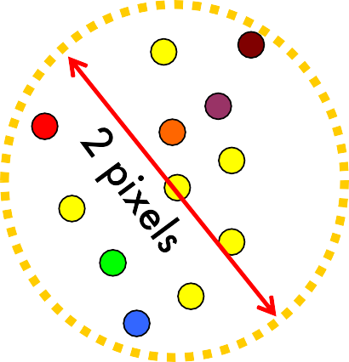
Example of normalization
T
Coordinate system of the image before applying T
Coordinate system of the image after applying T
Origin = centroid of image points
Mean square distance of the image points from origin is ~2 pixels

Slide 44









Slide 45
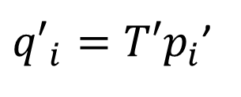

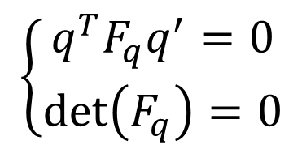

The Normalized Eight-Point Algorithm
Compute T and T’ for image 1 and 2, respectively
Normalize coordinates in images 1 and 2:
$$q_{i}=Tp_{i}$$
${q′}_{i}=T′p_{i}$’
2. Use the eight-point algorithm to compute F^{ˆ} from the
q
corresponding points q and q’ .
i
i
1. Enforce the rank-2 constraint: → F_{q}
such that:
$$\left\{\begin{matrix}q^{T}F_{q}q^{′}=0 \\ \det\left(F_{q}\right)=0\end{matrix}\right.$$
2. De-normalize
$$F_{q}∙F=T^{T}F_{q}T′$$

Slide 46

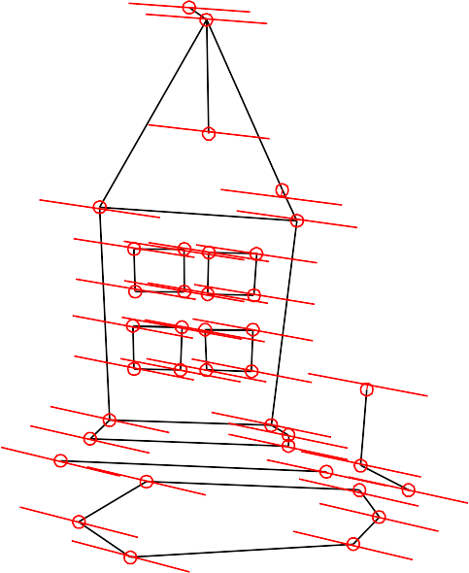
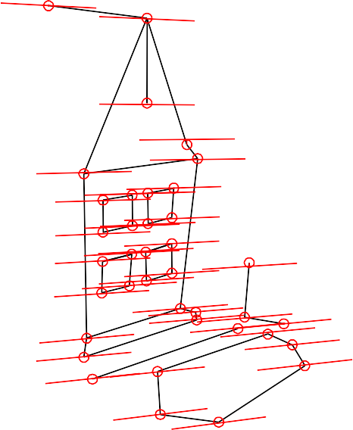
Mean errors: 10.0pixel 9.1pixel
Without normalization
Mean errors: 1.0pixel 0.9pixel
With normalization

Slide 47
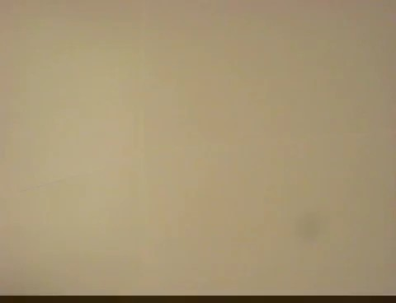
The Fundamental Matrix Song
http://danielwedge.com/fmatrix/

Slide 48
Next lecture:
Stereo systems
Silvio Savarese
Lecture 5 -
24-Jan-18

Slide 50
Example: Parallel image planes
P
v
e
p
p’
e’
y
u
z
O₁
x
O₂
E=?
Hint :
R = I
K₁=K₂ = known
x parallel to O₁O₂
T = (T, 0, 0)

Slide 51
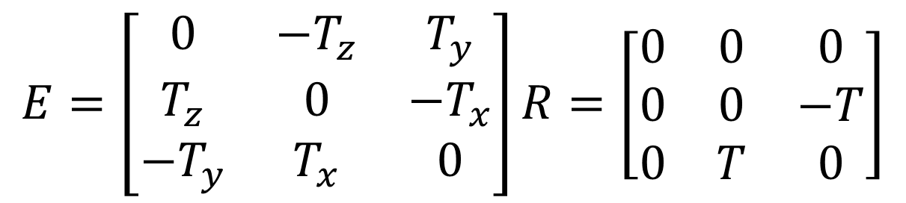
Essential matrix for parallel images
E = [T× ]× R
$$E=\left[\begin{matrix}0 & −T_{z} & T_{y} \\ T_{z} & 0 & −T_{x} \\ −T_{y} & T_{x} & 0\end{matrix}\right]R=\left[\begin{matrix}0 & 0 & 0 \\ 0 & 0 & −T \\ 0 & T & 0\end{matrix}\right]$$
[Eq. 20]
T = [ T 0 0 ]
R = I

Slide 52
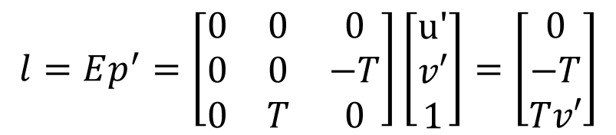
Example: Parallel image planes
P
v
v’
e
l
p
p’
l’
e’
y
u
u’
z
O₁
What are the directions of epipolar lines?
x
$$l=Ep^{′}=\left[\begin{matrix}0 & 0 & 0 \\ 0 & 0 & −T \\ 0 & T & 0\end{matrix}\right]\left[\begin{matrix}u′ \\ v′ \\ 1\end{matrix}\right]=\left[\begin{matrix}0 \\ −T \\ Tv′\end{matrix}\right]$$
horizontal!

Slide 53

Example: Parallel image planes
P
v
v’
e
p
p’
e’
y
u
u’
z
O₁
How are p and p’ related?
x
$$p^{T}∙Ep^{′}=0$$

Slide 54
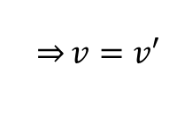
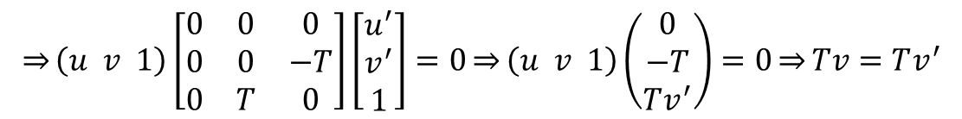
Example: Parallel image planes
P
v
v’
e
p
p’
e’
y
u
u’
z
O₁
x
How are p
$$\overset{⇒}{}\left(u v 1\right)\left[\begin{matrix}0 & 0 & 0 \\ 0 & 0 & −T \\ 0 & T & 0\end{matrix}\right]\left[\begin{matrix}u^{′} \\ v^{′} \\ 1\end{matrix}\right]=0\overset{⇒}{}\left(u v 1\right)\left(\begin{matrix}0 \\ −T \\ Tv^{′}\end{matrix}\right)=0\overset{⇒}{}Tv=Tv^{′}$$
and p’ related?
p^{T}E p′ = 0
$$\overset{⇒}{}v=v′$$

Slide 55
Example: Parallel image planes
P
v
v’
e
p
p’
e’
y
u
u’
z
O₁
x
Rectification: making two images “parallel”
Why it is useful?
Epipolar constraint → v = v’
New views can be synthesized by linear interpolation

Slide 56
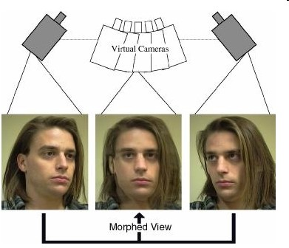
Application: view morphing
S. M. Seitz and C. R. Dyer, Proc. SIGGRAPH 96, 1996, 21-30

Slide 57
Rectification
P
H₁
I₁
I_{s}
î₁
u
I₂
v
î_{S}
u
v
C₁
H₂
u
v
î₂
C_{s}
C₂

Slide 58
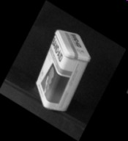



Slide 59
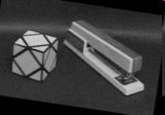
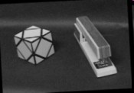
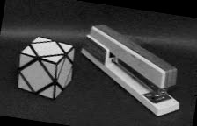


Slide 60





Slide 61
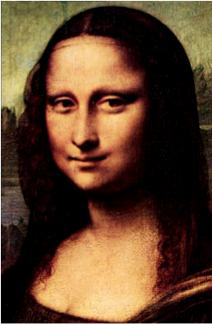
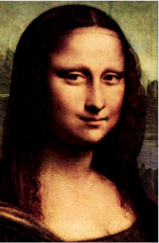
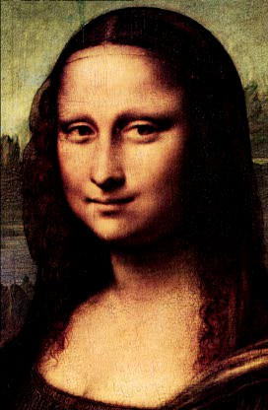

From its reflection!

Slide 62
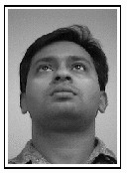




Slide 63

Deep view morphing
D. Ji, J. Kwon, M. McFarland, S. Savarese, CVPR 2017

Slide 64


Deep view morphing
D. Ji, J. Kwon, M. McFarland, S. Savarese, CVPR 2017

Slide 65


Deep view morphing
D. Ji, J. Kwon, M. McFarland, S. Savarese, CVPR 2017

